Slide 1
MAJOR PROJECT
Presented By:
Shubhankar Kaushik (21102031)
Saksham Saha (21102033)
Notes:
© Copyright PresentationGO.com – The free PowerPoint and Google Slides template library

Slide 2
INTRODUCTION
Notes:
© Copyright PresentationGO.com – The free PowerPoint and Google Slides template library

Slide 3
PROBLEM STATEMENT
Navigation and Obstacle Avoidance in Autonomous Vehicles
Notes:
© Copyright PresentationGO.com – The free PowerPoint and Google Slides template library

Slide 4
OBJECTIVE
The objective of this project is to develop an autonomous car system capable of real-time object detection and decision-making. Some key points are:
Create ROS setup environment
Make a map in Gazebo with the help of cartographer
Navigate through the obstacle course generated in gazebo sim environment.
Implement the stack on hardware
Notes:
© Copyright PresentationGO.com – The free PowerPoint and Google Slides template library

Slide 5
SOFTWARE FRAMEWORK & TOOLS
Notes:
© Copyright PresentationGO.com – The free PowerPoint and Google Slides template library

Slide 6
ROS2 (Robot Operating System 2)
Advanced middleware framework for real-time robotics.
Facilitates seamless communication between sensor processing, motion planning, and control systems.
Offers modular architecture for scalability and reliability.
Enhances autonomous navigation performance in complex environments.
Notes:
© Copyright PresentationGO.com – The free PowerPoint and Google Slides template library

Slide 7
DWB (Dynamic Window Approach) Path Planner
Local planner for real-time obstacle avoidance.
Evaluates possible velocity commands and selects the optimal one.
Considers factors like trajectory feasibility, obstacle clearance, and goal alignment.
Ensures smooth and adaptive navigation in dynamic environments.
Notes:
© Copyright PresentationGO.com – The free PowerPoint and Google Slides template library

Slide 8

Gazebo Simulator
High-fidelity robotics simulator with realistic physics and sensor emulation.
Enables safe and repeatable testing of navigation strategies.
Integrates seamlessly with ROS2 for real-world scenario simulation.
Reduces risks and costs associated with physical robot testing.
Notes:
© Copyright PresentationGO.com – The free PowerPoint and Google Slides template library

Slide 9
LiDAR (Light Detection and Ranging)
Measures distances using laser pulses and reflections.
Generates accurate 3D maps for environment perception.
Essential for obstacle detection, SLAM, and autonomous navigation.
Enhances spatial awareness for safe and efficient movement.
Notes:
© Copyright PresentationGO.com – The free PowerPoint and Google Slides template library

Slide 10
IMU (Inertial Measurement Unit)
Provides orientation, acceleration, and angular velocity data.
Helps maintain stability and track robot movement.
Improves localization accuracy when combined with LiDAR.
Essential for precise navigation in dynamic or uneven environments.
Notes:
© Copyright PresentationGO.com – The free PowerPoint and Google Slides template library

Slide 11

Google Cartographer
A real-time SLAM (Simultaneous Localization and Mapping) solution.
Uses LiDAR and IMU data to create high-quality 2D maps.
Supports loop closure detection for drift correction.
Provides accurate localization for autonomous robots.
Notes:
© Copyright PresentationGO.com – The free PowerPoint and Google Slides template library

Slide 12

Nav2
A ROS2-based navigation stack for autonomous robots.
Supports global and local path planning, obstacle avoidance, and recovery behaviors.
Integrates with sensors like LiDAR and IMU for accurate navigation.
Offers modular design for customization and scalability in different environments.
Notes:
© Copyright PresentationGO.com – The free PowerPoint and Google Slides template library

Slide 13
Problems Faced
During the software simulation and hardware implementations we faced some problems which are listed below:
Not enough GPU power to run the simulation smoothly (30fps).
Low quality LiDar, transmission rate very slow. (3Hz)
RaspBerry pi had low computation power. (unable to run the tech stack)
Getting imu data and controlling the motors with RPI.
Workaround - Controlling them using an arduino
Notes:
© Copyright PresentationGO.com – The free PowerPoint and Google Slides template library

Slide 14
RESULTS
Notes:
© Copyright PresentationGO.com – The free PowerPoint and Google Slides template library

Slide 15
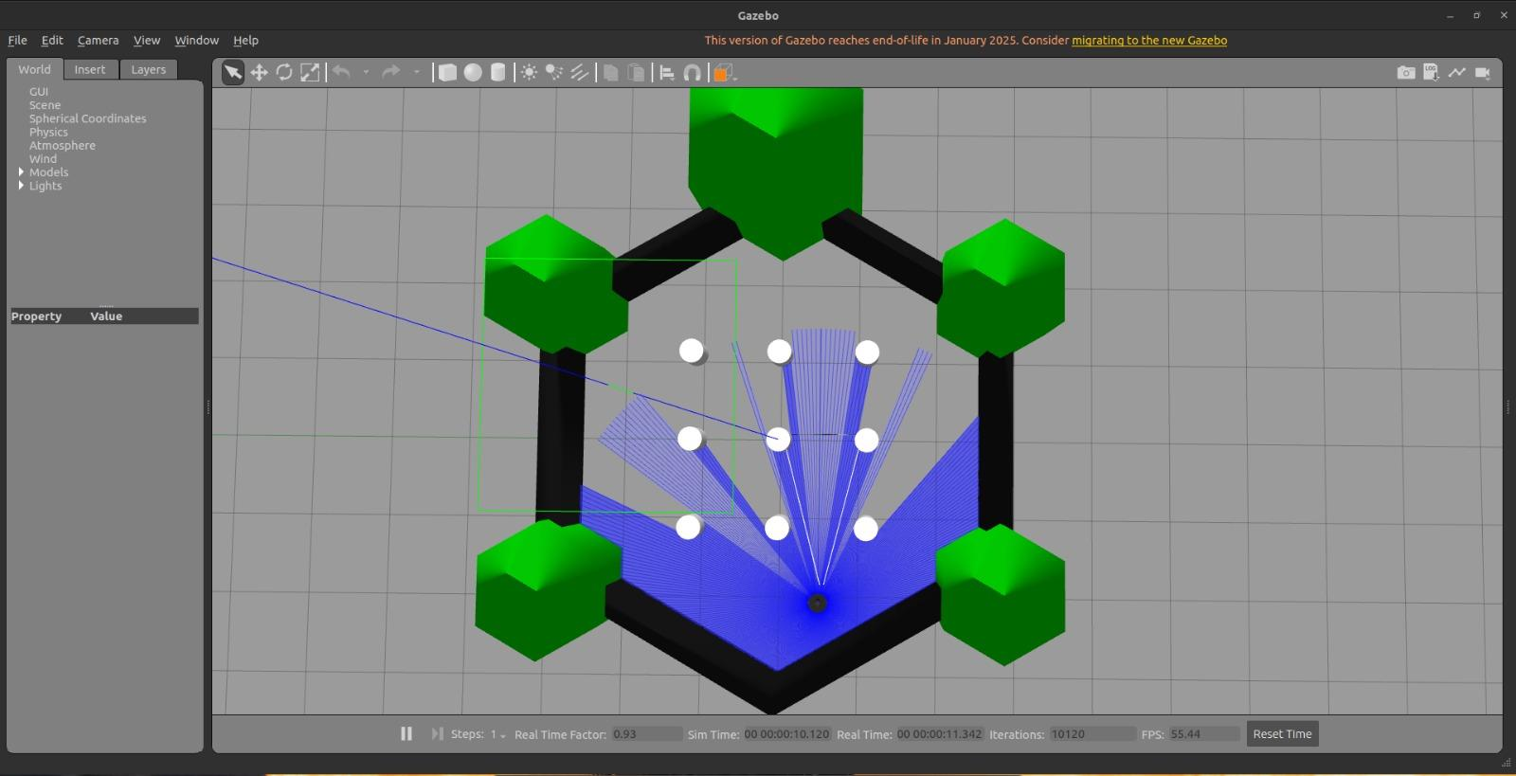
Gazebo Simulation
Notes:
© Copyright PresentationGO.com – The free PowerPoint and Google Slides template library

Slide 16
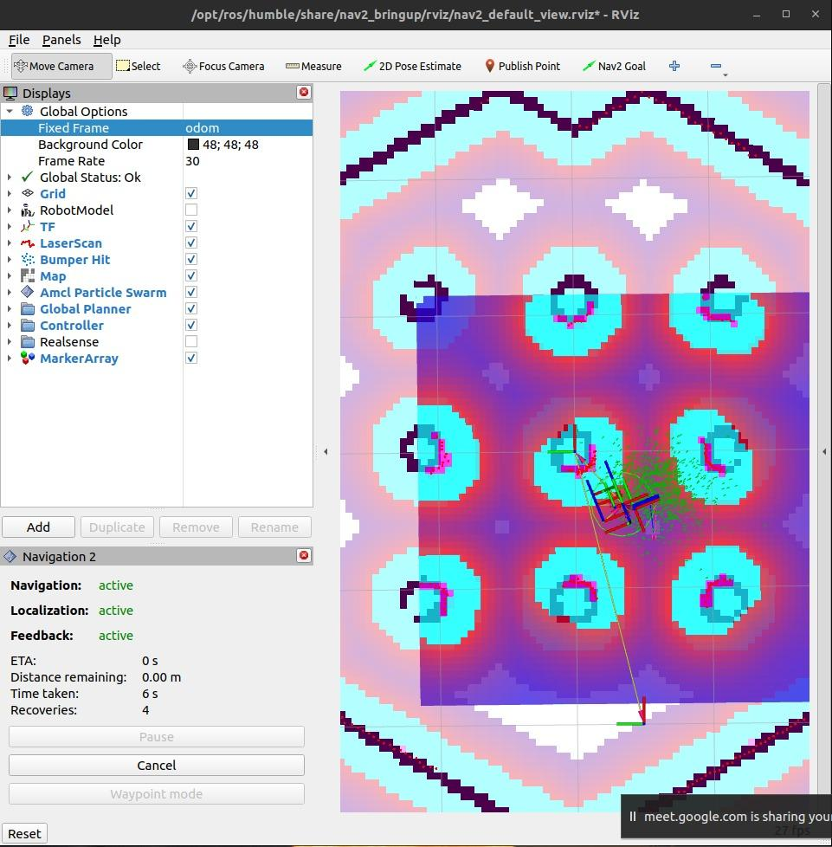
Rviz Navigation
Notes:
© Copyright PresentationGO.com – The free PowerPoint and Google Slides template library

Slide 17
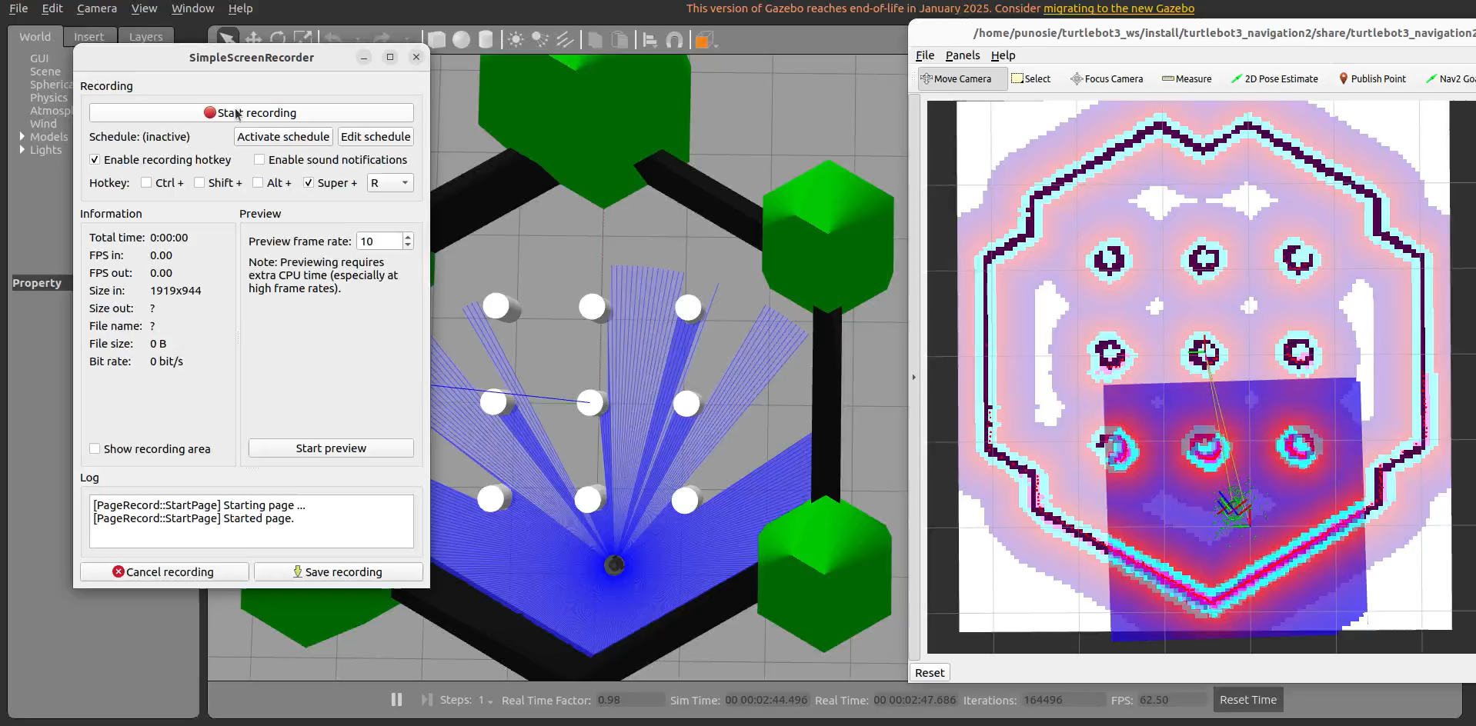
Simulation Video
Notes:
© Copyright PresentationGO.com – The free PowerPoint and Google Slides template library

Slide 18
Thank You!
Notes:
© Copyright PresentationGO.com – The free PowerPoint and Google Slides template library

